Slide 1

I’m Available
CSC102 Object Oriented Programming
Avail Anytime!
Team
Roll No. Name Programme
AU1841069 Umang Kamdar BTECH ICT
AU1841138 Vardhan Shah BTECH ICT
AU1841107 Vijay Rana BTECH ICT

Slide 2
Problem Definition
We can see that nowadays, people of the same organisation commute in a different-different ways, even though their destination is same.
Two persons having the same or nearby drop-off location uses their own individual vehicles instead of a single vehicle.
This creates needless use of the extra vehicle leading to more traffic and useless extra petrol cost.

Slide 3
Objective and End Users
Objective of the project
Helping Commuters of a specific organisation.
Software End Users
Students, Staffs (of a particular organisation)

Slide 4
Functionality/features
Login
Message via Mail
Bill Split
List of available destinations
Filter desired location
Profile of a Person
Info
Mode of accommodation
Most visited place

Slide 5


Slide 6
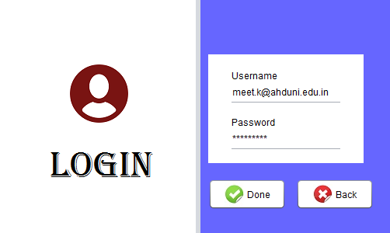

Slide 7
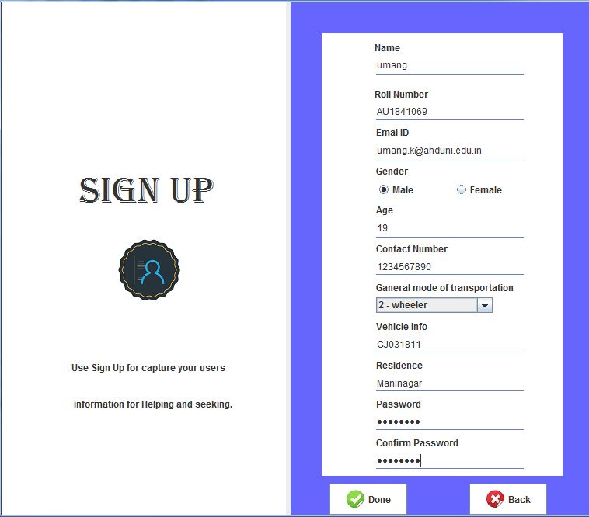

Slide 8
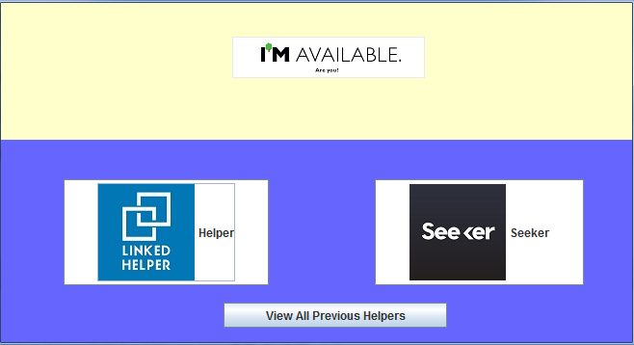

Slide 9
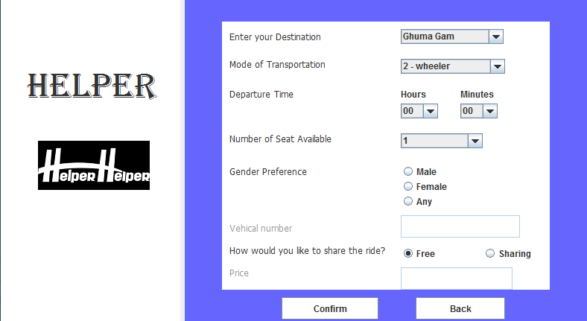

Slide 10
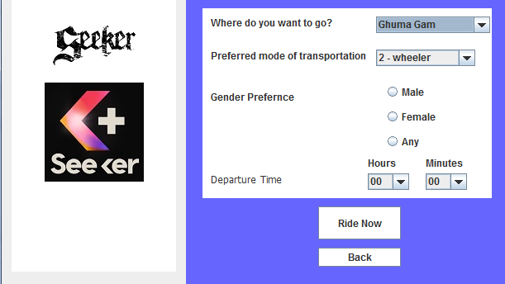

Slide 11
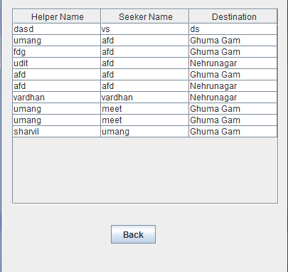

Slide 12
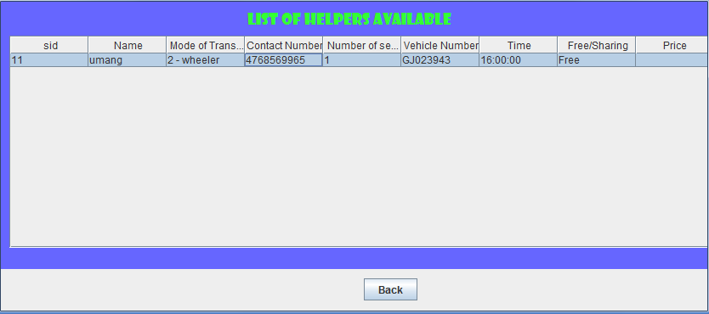

Slide 13
